Slide 1
Flight Price Prediction
Government Arts and Science College Perumbakkam
By Saravanan.V
Jothishwaran.P
Arjun.E
Mathiyazhgan.R

Slide 2
Index
Why we are making this project
What we are doing
Algorithm to be used
Flowchart
Challenge that we have faced
What we had done
What we need to do in future

Slide 3
Introduction
As we know that in this era, everyone needs as application by using which they can get the solution of their problem
Our flight fare prediction appoa a machine learning based project which will predict the flight fare depends upon various features like number of Stoppage, Airlines you want to travel, source, destination, departure date, arrival date, duration of flight etc

Slide 4
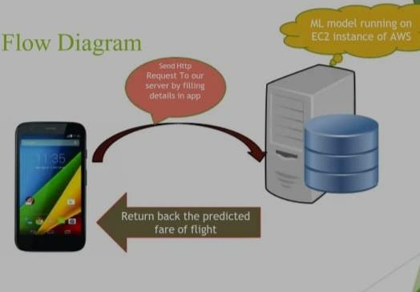

Slide 5
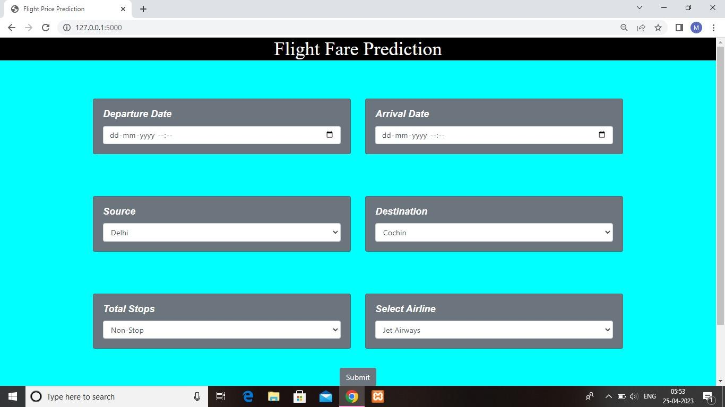
Hypothesis
Glance of User Interface

Slide 6
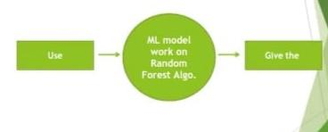
Level-0, DFD

Slide 7
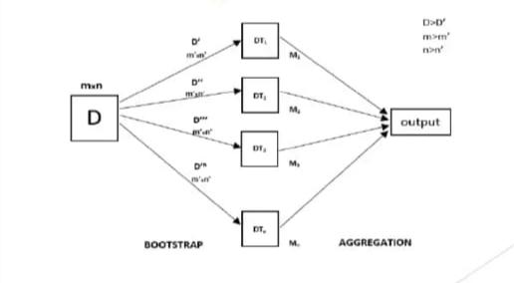
Tell the audience what you expect to happen...
Pictorial Presentation of Random forest Regressir6

Slide 8
Software used in this project
Jupiter Notebook:,To perform various Machine learning techniques on the dataset
Pycharm: used to run server using the Flask Package
VS Code; used to run the HTML,CSS and JavaScript file for web deployment

Slide 9

Diving into the Dataset Problems that we found
Feature selection and feature elimination: which features should we should select and which feature to eliminate
How to deal with the string data type in our Dataset or how to deal with the catogorical features

Slide 10
Things we have completed
We are done with our Machine Learning mode
We have created our web user interface
We have also configured our server

Slide 11
Things need to be Done
We need to develop our mobile application which gonna run on Android as well as IOS
We need to transfer our Machine learning model to the cloud or server running as AWS

